Slide 1
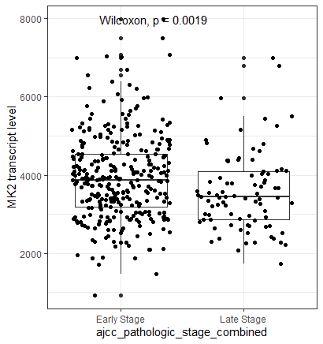
Boxplot show mean+/- SD of MK2 transcript levels in the TCGA-LUAD (Lung cancer) dataset. We divided the tumor stage into Early (Stage I-IIB) and Late (Stage IIIA and IV). MK2 expression was extracted from TCGA mRNA sequencing data

Slide 2
MK2 expression and death at 1 and 2 years in TCGA-LUAD (n=492)
Endpoint | 1 year mortality
Tumor Stage | Early Stage |  | Late Stage
Model Type | Model 1ª HR (95% CI) | Model 2^{b} OR (95% CI) | Model 1 HR (95% CI) | Model 2 OR (95% CI)
High MK2 expression^{c} | 0.24 (0.07-0.80) | 0.22 (0.06,0.77) | 0.48 (0.14,1.66) | 0.48 (0.12,1.92)
Male Sex | 2.2 (0.99-5.11) | 2.20 (0.92, 5.22) | 1.21 (0.53,2.76) | 1.40 (0.51,3.78)
Smoking | 1.06 (0.42,2.69) | 1.18 (0.44,3.14) | 0.81 (0.35,1.90) | 0.68 (0.24,1.90)
Age | 0.98 (0.94, 1.02) | 0.98 (0.94,1.02) | 1.02 (0.98,1.07) | 1.02 (0.97,1.08)
2 year mortality
Early Stage |  | Late Stage
Model 1ª HR (95% CI) | Model 2^{b} OR (95% CI) | Model 1 HR (95% CI) | Model 2 OR (95% CI)
0.52 (0.28,0.98) | 0.49 (0.25,0.98) | 0.61 (0.27,1.40) | 0.70 (0.23,2.03)
1.52 (0.89,2.60) | 1.47 (0.81,2.70) | 1.0 (0.53,1.89) | 0.97 (0.40,2.34)
1.36 (0.71,2.60) | 1.45 (0.71,2.95) | 0.90 (0.46,1.75) | 0.77 (0.30,1.95)
1.0 (0.97,1.03) | 1.0 (0.97,1.03) | 1.01 (0.98,1.05) | 1.01 (0.97,1.06)
ª Model 1: Cox Proportional hazards modeling of time to death, right censored at 2 years, as a function of high MK2 expression (dichomotous: top 1/3 vs bottom 2/3 of transcript expression), adjusted for age, sex and smoking status
^{b} Model 2: Logistic regression modeling death at 2 years as a function of high MK2 expression, adjusted for age, sex, and smoking status
^{c} Top 1/3 of MK2 transcript levels (reference: bottom 2/3)

Slide 3
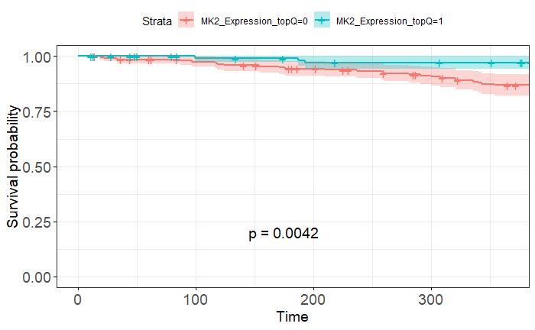
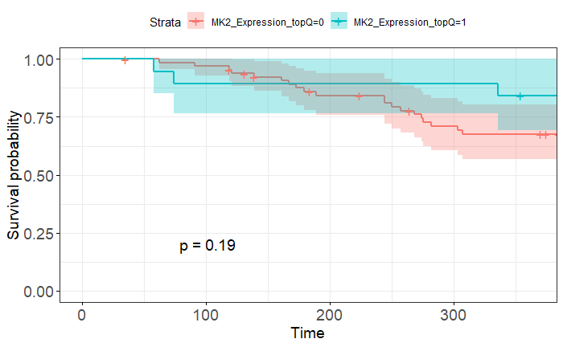
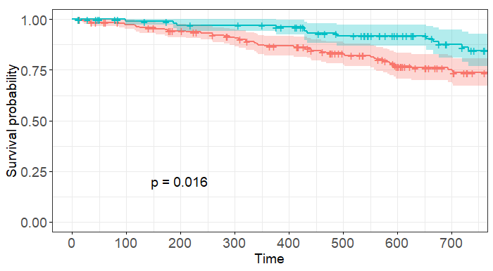
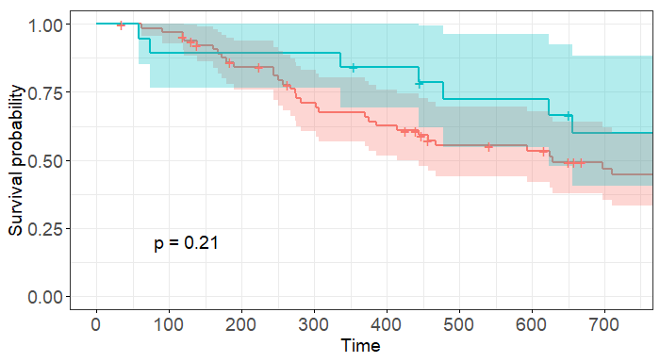
Early Stage NSCLC
Late Stage NSCLC
1 year mortality
High MK2 Expression (top 1/3)
Low MK2 Expression (bottom 2/3)
High MK2 Expression (top 1/3)
Low MK2 Expression (bottom 2/3)
Early Stage NSCLC
2 year mortality
High MK2 Expression (top 1/3)
Low MK2 Expression (bottom 2/3)
High MK2 Expression (top 1/3)
Low MK2 Expression (bottom 2/3)
Kaplan-Meier curves showing 1-year (top row) and 2-year (bottom row) survival in patients with early stage (left column) and late stage (right column) NSCLC in the TCGA-LUAD dataset, stratified by high (teal) and low (red) MK2 transcript levels. High MK2 transcript level was defined as top 1/3 of MK2 transcript levels in the dataset. Time is shown in days.

Slide 4
MK2 expression and 2-year mortality in validation cohort (n=305)
Model type | Early Stage
Variable | Model 1ª HR (95% CI) | Model 2^{b} OR (95% CI)
High MK2 expression^{c} | 0.10 (0.01,0.81) | 0.08 (0.004,0.154)
Male Sex | 1.29 (0.40,4.20) | 1.32 (0.33,5.28)
Smoking | 3.44 (1.01, 11.74) | 4.38 (1.15,18.89)
Age | 1.02 (0.98,1.08) | 1.04 (0.98,1.10)
Late Stage^{d} | 3.81 (1.42,10.21) | 4.99 (1.54,16.83)
ª Model 1: Cox Proportional hazards modeling of time to death, right censored at 2 years, as a function of high MK2 expression (dichomotous: top 1/3 vs bottom 2/3 of transcript expression), adjusted for age, sex smoking status and tumor stage
^{b} Model 2: Logistic regression modeling death at 2 years as a function of high MK2 expression, adjusted for age, sex, smoking status and tumor stage
^{c} Top 1/3 of MK2 transcript levels (reference: bottom 2/3)
^{d} Early Stage: Stage I/II; Late Stage: Stage III/IV

Slide 5
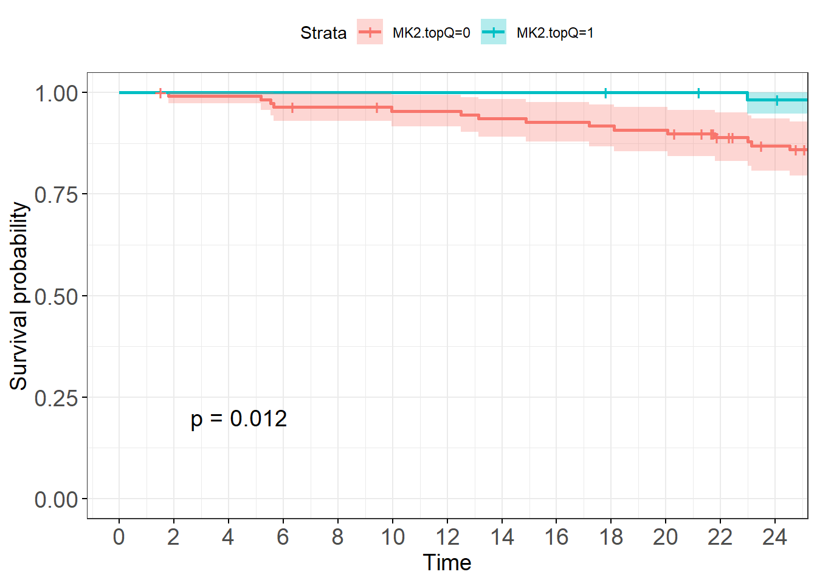
High MK2 Expression (top 1/3)
Low MK2 Expression (bottom 2/3)
Kaplan-Meier curve showing 2 year survival in patients with lung adenocarcinoma in the validation dataset, stratified by high (teal) and low (red) MK2 transcript levels. High MK2 transcript level was defined as top 1/3 of MK2 transcript levels in the dataset. Time is shown in months.

Slide 6
Data to be included in the supplemental

Slide 7
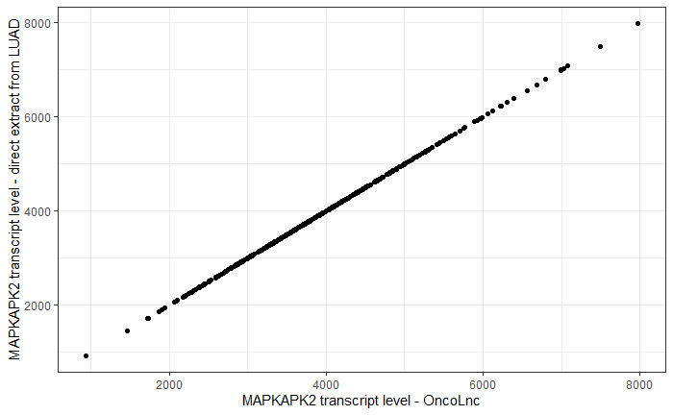
Scatterplot comparing MK2 transcript levels obtained via two different methods: a) download of data using the OncoLnc web interface and b) extraction of MK2 transcript reads from the TCGA directly, via GDC.

Slide 8
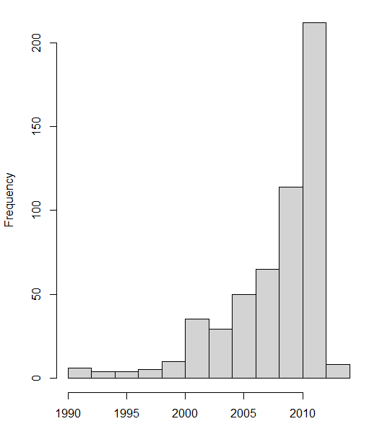
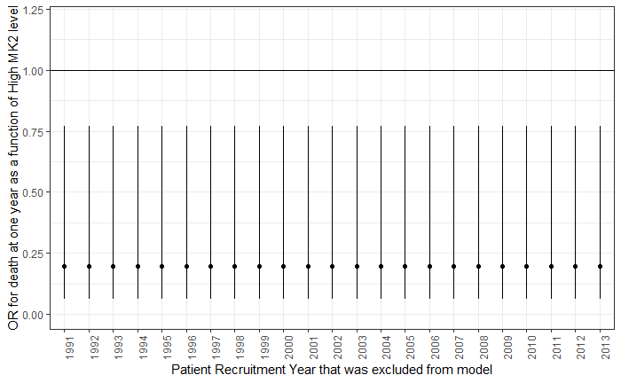
Left: Bar graph showing histogram of numer of patients recruited per year in the TCGA-LUAD dataset. Right: Jackknife analysis showing point estimate and 95% CI for odds ratio for high MK2 transcript level and death at one year following removal (with replacement) of patients recruited at one particular year within the LUAD dataset.

Slide 9
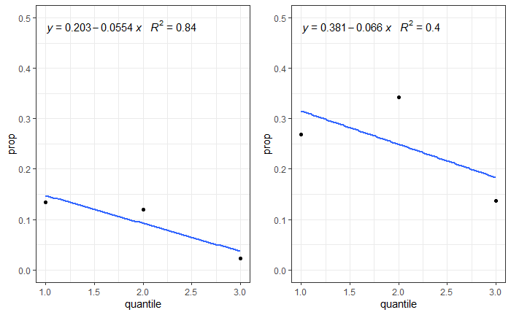
Early stage
Late stage
Scatterplots with linear regression line showing proportion of people who died within each quantile of MK2 expression in early- and late-stage NSCLC

Slide 10
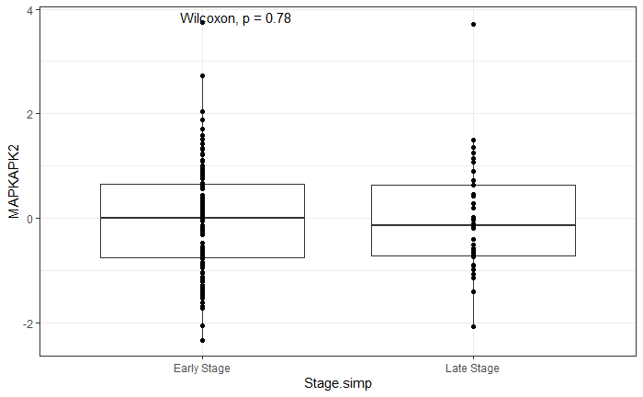
Boxplot show mean+/- SD of MK2 transcript levels in the validation lung cancer dataset. We divided the tumor stage into Early (Stage I-IIB) and Late (Stage IIIA and IV). Clinical data and MK2 expression were downloaded from cBioPortal

Slide 11
Extra data – not included in supplemental

Slide 12
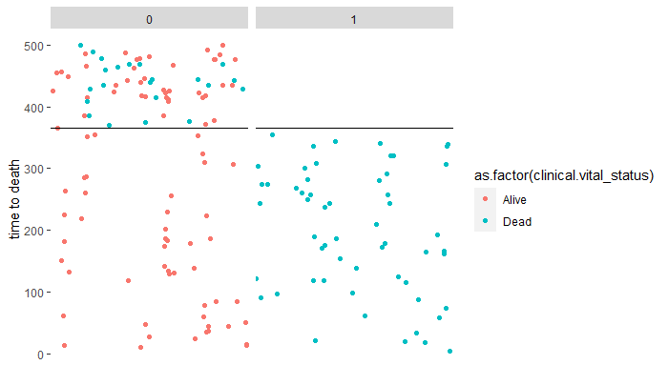
Death at one year status
Validation plot to make sure that censoring at one year was done properly. So, we have colored each patient’s vital status by alive or dead, and we have faceted by whether they were assigned as “Death in one year” or not. So, if our code worked, all patients who died in less than one year (blue color; y < 365) should be classified as dead at one year (“1”). All patients who were alive in that time period should be classified as red and in the “0” column. After 365 days, everyone should have gotten a classification of “0” for death at one year, since they are all by definition still alive at 1 year, regardless of subsequent alive or dead status (color should mix, all colors in the “0” column). And that’s what we see…

Slide 13
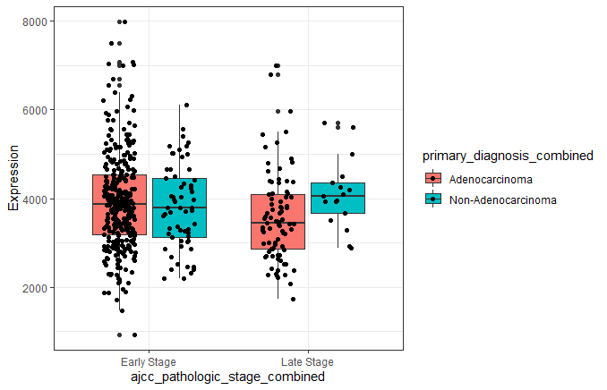
Boxplot show mean+/- SD of MK2 transcript levels in the TCGA-LUAD (Lung cancer) dataset subdivided by both stage and tumor histology. Though LUAD is a adenocarcinoma dataset, it does include some non-adenocarcinoma samples. We divided the tumor stage into Early (Stage I-IIB) and Late (Stage IIIA and IV). MK2 expression was extracted from TCGA mRNA sequencing data

Slide 14
MK2 expression and death at 1 year in TCGA-LUAD
Model type
Variable | Model 1ª HR (95% CI) | Model 2^{b} OR (95% CI) | Model 1 HR (95% CI) | Model 2 OR (95% CI)
High MK2 expression^{c} | 0.24 (0.07-0.80) | 0.22 (0.06,0.77) | 0.48 (0.14,1.66) | 0.48 (0.12,1.92)
Male Sex | 2.2 (0.99-5.11) | 2.20 (0.92, 5.22) | 1.21 (0.53,2.76) | 1.40 (0.51,3.78)
Smoking | 1.06 (0.42,2.69) | 1.18 (0.44,3.14) | 0.81 (0.35,1.90) | 0.68 (0.24,1.90)
Age | 0.98 (0.94, 1.02) | 0.98 (0.94,1.02) | 1.02 (0.98,1.07) | 1.02 (0.97,1.08)
ª Model 1: Cox Proportional hazards modeling of time to death, right censored at 1 year, as a function of high MK2 expression (dichomotous: top 1/3 vs bottom 2/3 of transcript expression), adjusted for age, sex and smoking status
^{b} Model 2: Logistic regression modeling death at one year as a function of high MK2 expression, adjusted for age, sex, and smoking status
^{c} Top 1/3 of MK2 transcript levels (reference: bottom 2/3)

Slide 15
MK2 expression and death at 2 years in TCGA-LUAD (n=492)
Model type | Early Stage |  | Late Stage
Variable | Model 1ª HR (95% CI) | Model 2^{b} OR (95% CI) | Model 1 HR (95% CI) | Model 2 OR (95% CI)
High MK2 expression^{c} | 0.52 (0.28,0.98) | 0.49 (0.25,0.98) | 0.61 (0.27,1.40) | 0.70 (0.23,2.03)
Male Sex | 1.52 (0.89,2.60) | 1.47 (0.81,2.70) | 1.0 (0.53,1.89) | 0.97 (0.40,2.34)
Smoking | 1.36 (0.71,2.60) | 1.45 (0.71,2.95) | 0.90 (0.46,1.75) | 0.77 (0.30,1.95)
Age | 1.0 (0.97,1.03) | 1.0 (0.97,1.03) | 1.01 (0.98,1.05) | 1.01 (0.97,1.06)
ª Model 1: Cox Proportional hazards modeling of time to death, right censored at 2 years, as a function of high MK2 expression (dichomotous: top 1/3 vs bottom 2/3 of transcript expression), adjusted for age, sex and smoking status
^{b} Model 2: Logistic regression modeling death at 2 years as a function of high MK2 expression, adjusted for age, sex, and smoking status
^{c} Top 1/3 of MK2 transcript levels (reference: bottom 2/3)

Slide 16
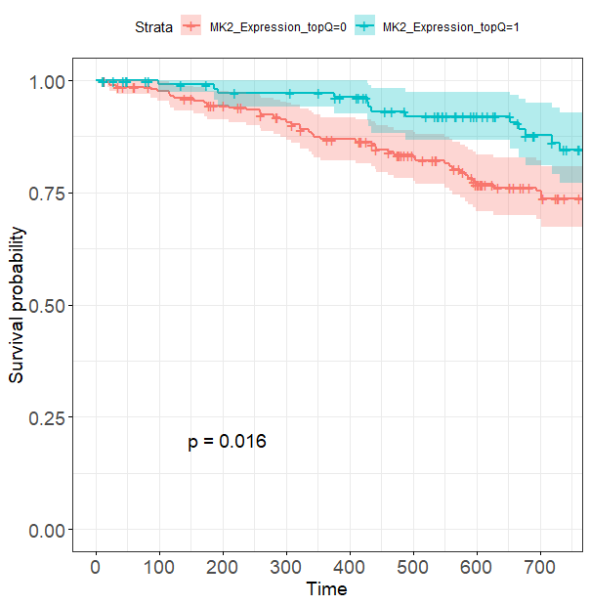
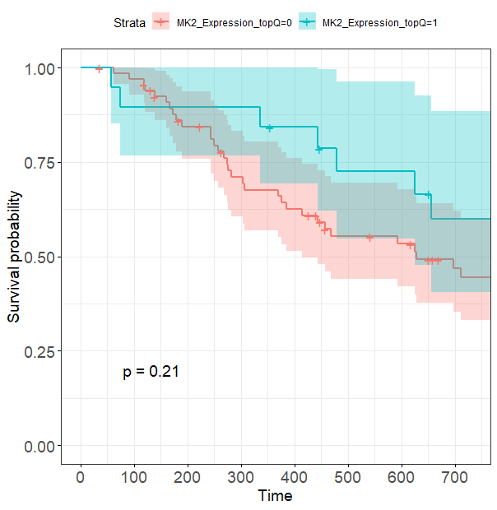
Early Stage NSCLC
Late Stage NSCLC
High MK2 Expression (top 1/3)
Low MK2 Expression (bottom 2/3)
High MK2 Expression (top 1/3)
Low MK2 Expression (bottom 2/3)

Slide 17
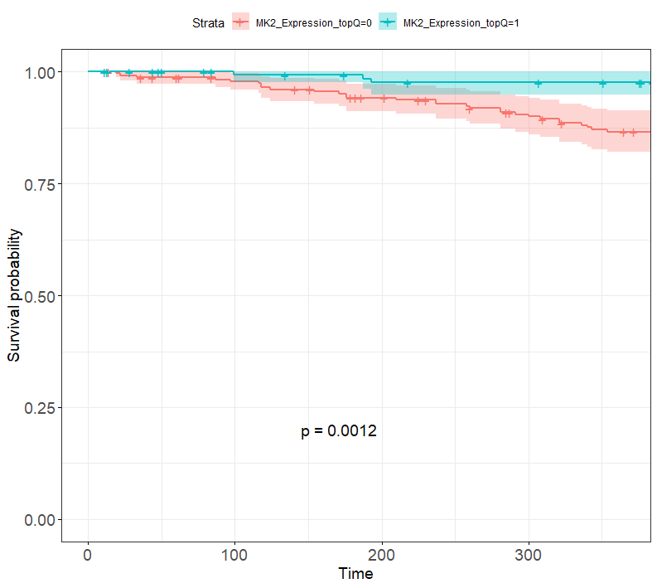
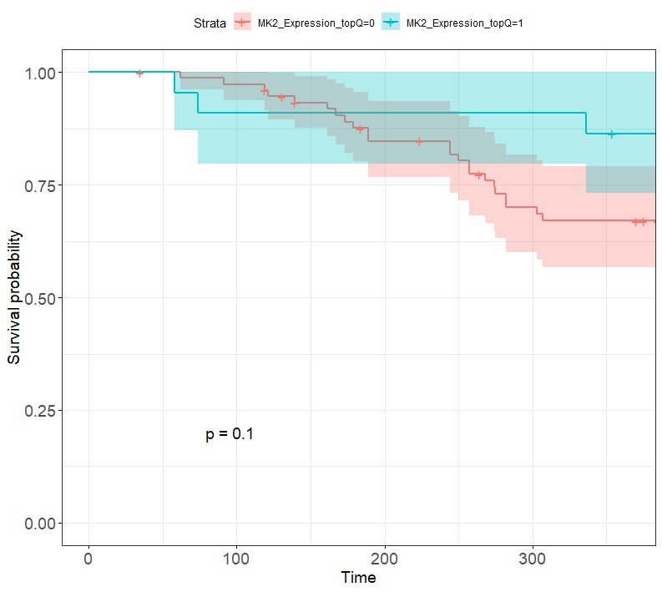
Early Stage NSCLC
High MK2 Expression (top 1/3)
Low MK2 Expression (bottom 2/3)
Late Stage NSCLC
High MK2 Expression (top 1/3)
Low MK2 Expression (bottom 2/3)

Slide 18
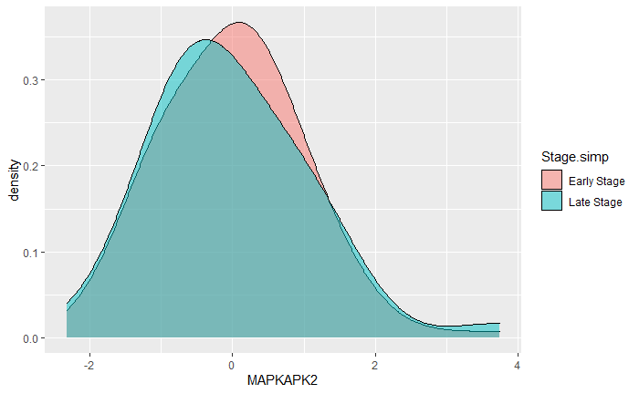

Slide 19
